Slide 1

Exploratory Data Analysis
G2M Case Study
Sept. 20 2024
David Kalen

Slide 2
Background & Agenda
US equity private firm XYZ has taken interest in the Cab Industry due to the it’s recent growth. They plan on making an investment. There are two companies that XYZ are deciding between: Yellow Cab and Pink Cab. This presentation is an analysis of which company is a better investment for XYZ to make.
The Analysis:
- Data Analysis
- Data Interpretation (understanding data relations with graphs/visuals)
- Conclusion Drawing (using the interpretation to come to a conclusion)
- Report Findings (make a recommendation on which investment is better)

Slide 3
Background
US equity private firm XYZ has taken interest in the Cab Industry due to the it’s recent growth. They plan on making an investment. There are two companies that XYZ are deciding between: Yellow Cab and Pink Cab. This presentation is an analysis of which company is a better investment for XYZ to make.
The Analysis:
- Data Analysis
- Data Interpretation (understanding data relations with graphs/visuals)
- Conclusion Drawing (using the interpretation to come to a conclusion)
- Report Findings (make a recommendation on which investment is better)

Slide 4
Data Sets
There are 4 individual data sets. Time period of data is from 31/01/2016 to 31/12/2018 Data Sets:
Cab_Data.csv – Details of transactions for Yellow Cab and Pink Cab
Customer_ID.csv – Links the customer’s demographic details
Transaction_ID.csv – Transactions to customer mapping and payment mode
City.csv – List of US cities, their population and number of cab users
Features
Cab_Data.csv ‎
Transaction ID
Data of Travel
Company
City
KM Travelled
Price Charged
Cost of Trip
Customer_ID.csv
‎
Customer ID
Gender Age
Income (USD/Month)
Transaction_ID.csv
‎
Transaction ID
Customer ID Payment_Mode
City.csv
‎ ‎
City
Population Users

Slide 5

Data Preparation
In order to use the data for analysis I first had to clean and arrange the data.
To clean the data I checked for outliers, duplicates, and null values. I found none of the these, but the data was still not ready to be used.
For two of the visuals created, I had to merge the data. I merged Transaction_ID.csv & Customer_ID.csv to Cab_Data.csv.
Transaction_ID.csv
Cab_Data.csv
Customer_ID.csv

Slide 6
Data Interpretation
In order to create a conclusion and recommendation based on the data, hypotheses were created to shape the visuals and help extrapolate meaning from the data.
Hypotheses:
Which company has the highest number of cab users in different cities?
Does the total revenue or margin per trip increase with distance (KM traveled)?
Is there a specific time period where one company sees a spike in users compared to the other?
What is the preferred payment method (cash or card) for each company's customers, and does this affect revenue?
Which company operates more efficiently in terms of cost vs. revenue per trip?
Over the time of data which company his increasing profits, and by how much?

Slide 7
Exploratory Data Analysis
G2M Case Study
Sept. 20 2024
David Kalen

Slide 8
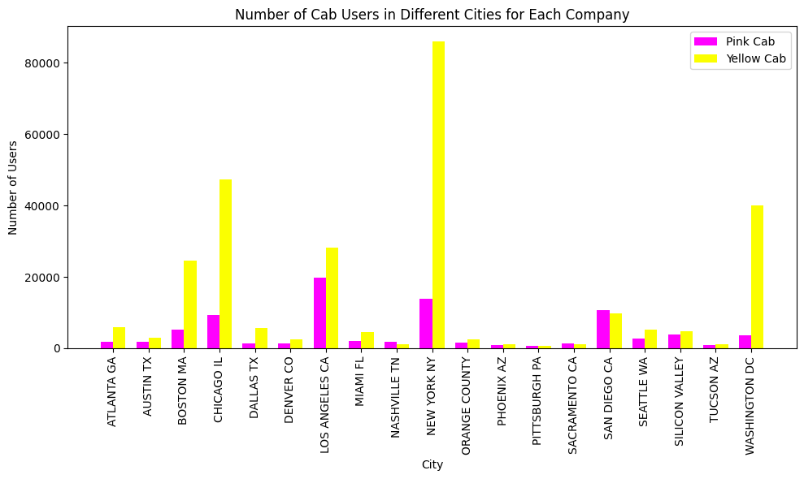
Which company has the highest number of cab users in different cities?
We can see that with the exception of San Diego and perhaps some smaller cities, the Yellow Cab Company has substantially more users in most cities.

Slide 9
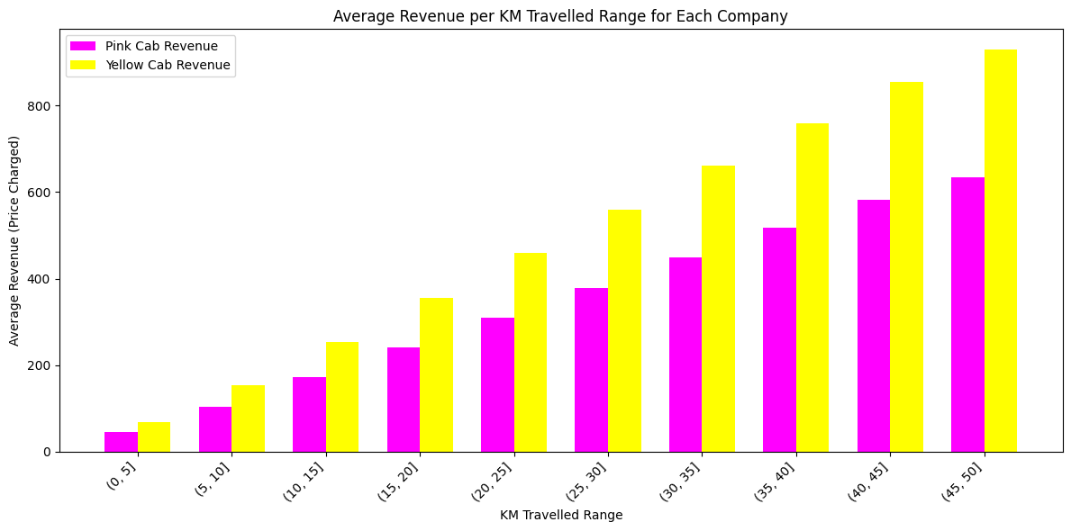
Does the total revenue or margin per trip increase with distance (KM traveled)?

Slide 10
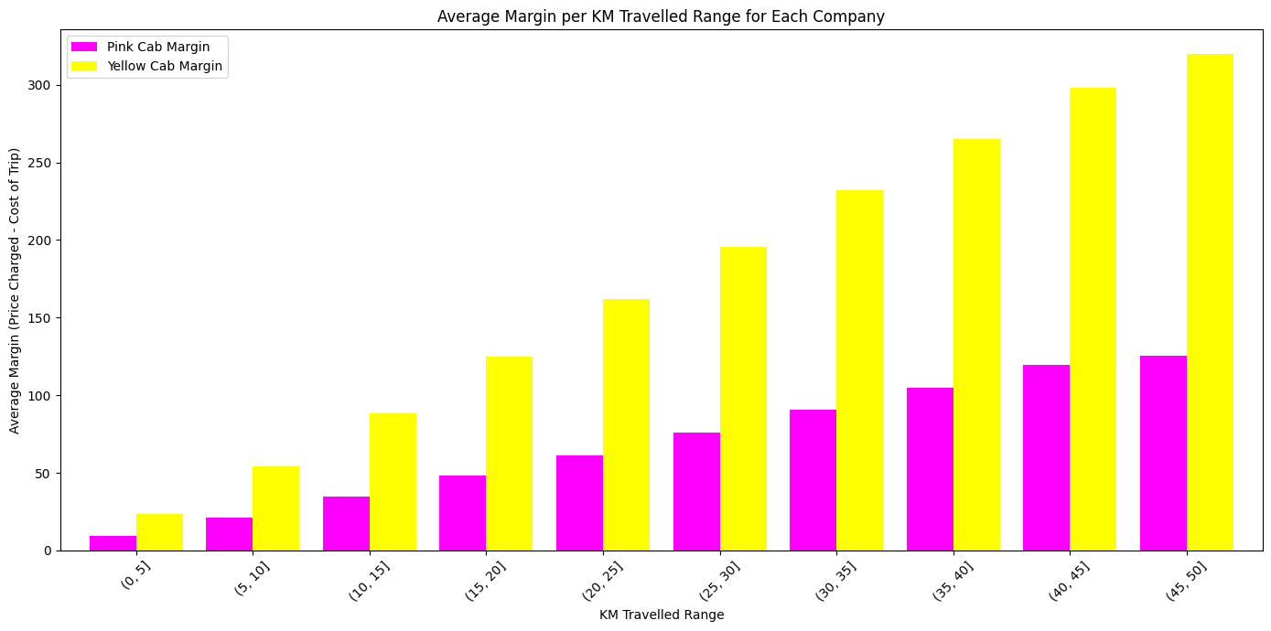
Does the total revenue or margin per trip increase with distance (KM traveled)?
When it comes to average revenue and margin per KM travelled, the Yellow Cab Company is ahead at every range shown in the graph. When comparing the two graphs, we can also see that the Yellow Cab company makes more profit per the revenue they make when compared to the Pink Cab Company

Slide 11
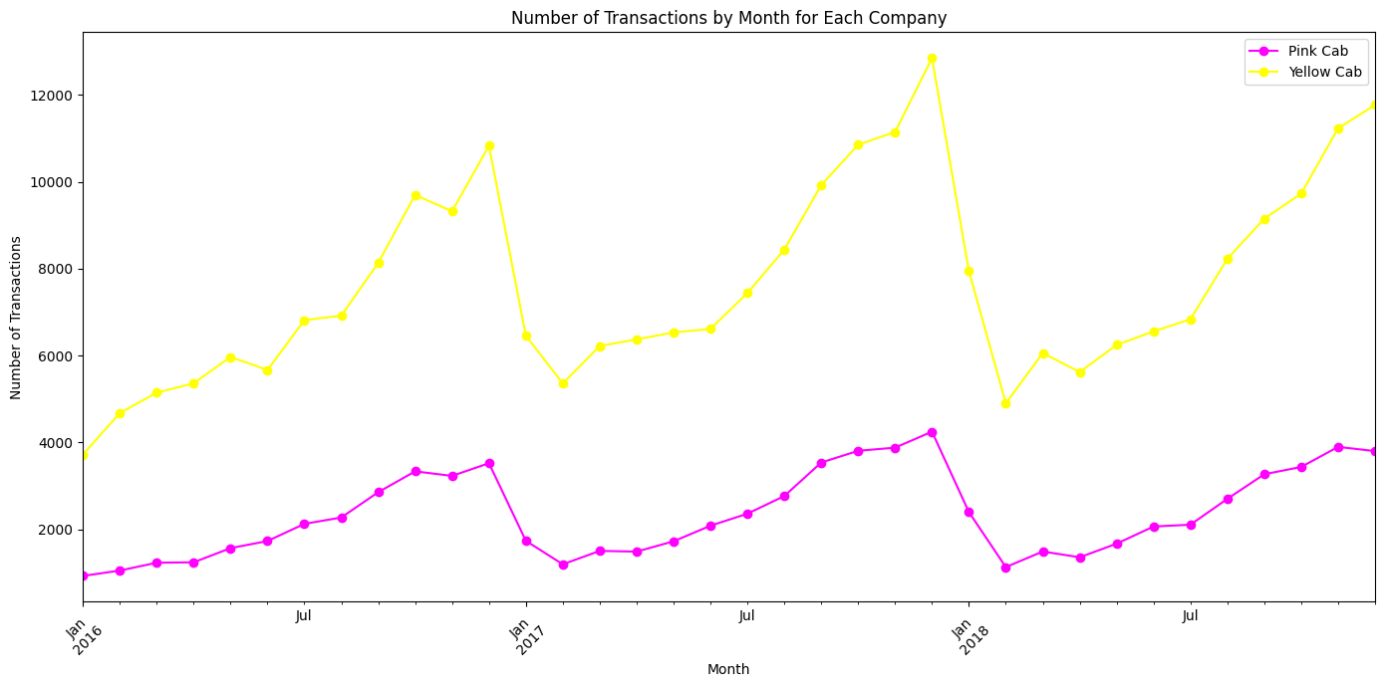
Is there a specific time period where one company sees a spike in users compared to the other?
We again see that the yellow cab company has more transactions throughout the entire year, but we can see an increase of transactions towards the end of each year in both companies.

Slide 12
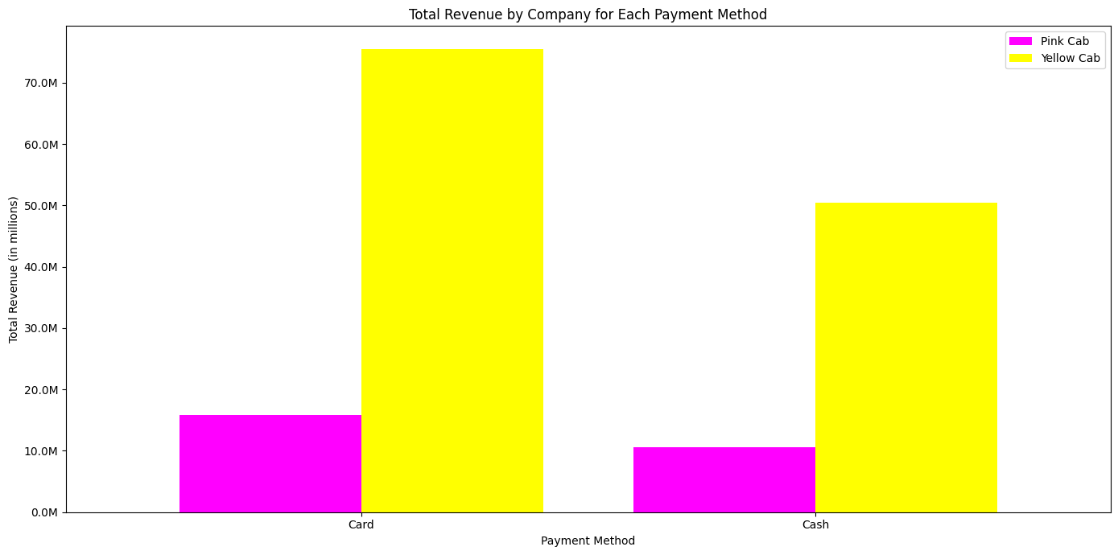
What is the preferred payment method (cash or card) for each company's customers, and does this affect revenue?
The preferred method of payment for both companies is card. Yellow Cab Company again is ahead.

Slide 13
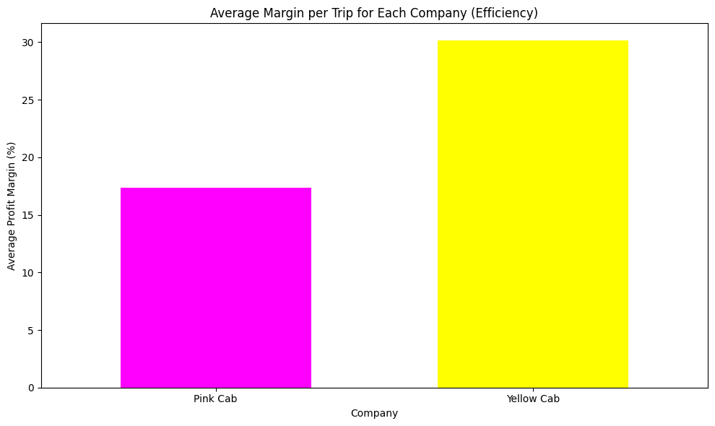
Which company operates more efficiently in terms of cost vs. revenue per trip?
Based on the visual here we can see that the Yellow Cab company operates approximately 1.70 times more efficiently than the Pink Cab company in terms of cost versus revenue per trip.

Slide 14
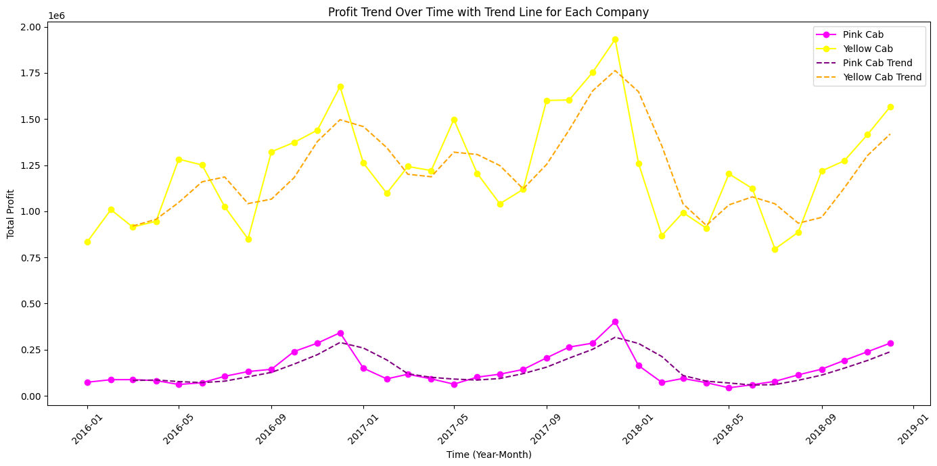
Over the time of data which company his increasing profits, and by how much?
There isn’t a trend that shows either company having a definitive increase of profits across the time of recorded transactions. We can see that the Yellow Cab company makes more than double the profit than the Pink Cab Company when averaging the entire trend.

Slide 15
Conclusion & Report Findings

Slide 16
Agenda
Executive Summary
Problem Statement
Approach
EDA
EDA Summary
Recommendations

Slide 17
Thank You

